Slide 1
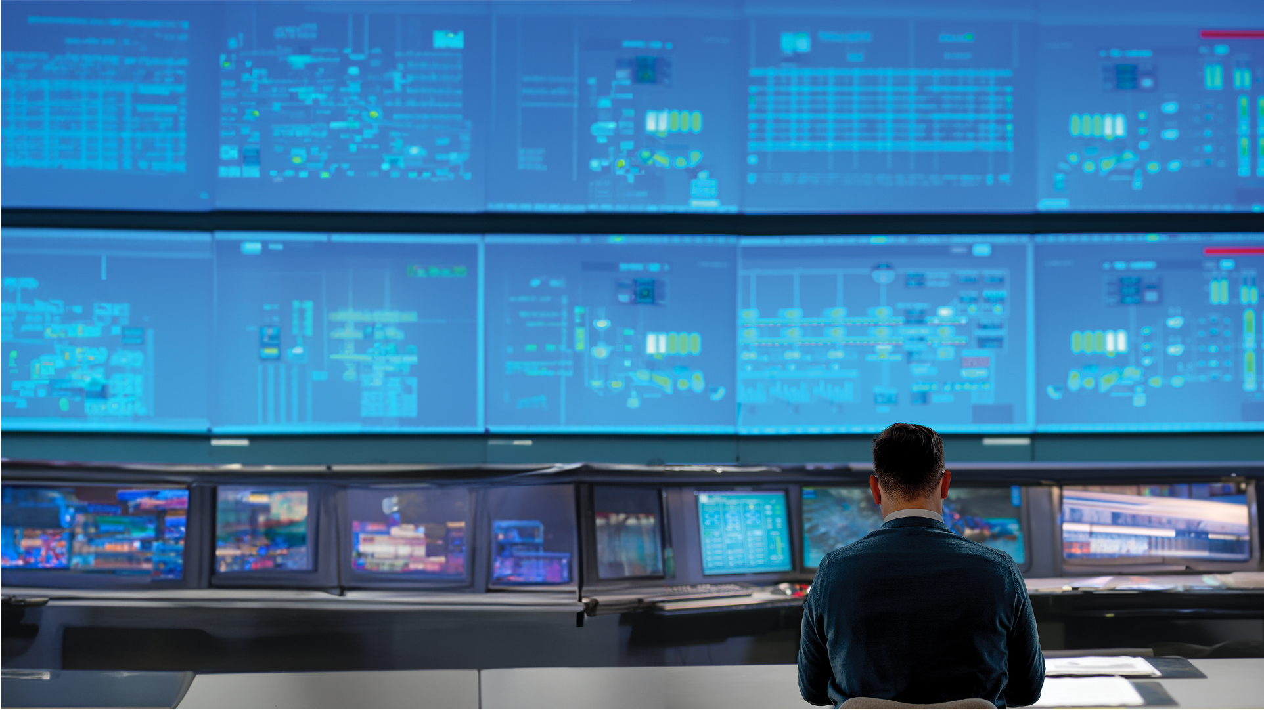
UOP REFORMING
NEW PRODUCT OFFERINGS
PRESENTER’S NAME
PRESENTER’s TITLE

Slide 2


HONEYWELL UOP CCR PLATFORMING™
HIGH DENSITY CATALYST PORTFOLIO
R-264
R-364
R-464
150+ Units
30+ Units
13 Units
Commercialization Update: 14 Sales
NAM – 3 units (3 S/U)
APAC – 5 units (3 S/U)
AFR – 3 units
ME – 2 units
EUR – 1 unit
HIGH
DENSITY
Better
Best
Better
Activity
Good
Better
Best
Yields
UOP’s portfolio can meet a variety of applications and needs

Slide 3


HONEYWELL UOP CCR PLATFORMING™
STANDARD DENSITY CATALYST PORTFOLIO
R-434
R-454
R-494
1 Unit
Mix-to-Order
R-400 SD CCR catalyst series can be blended to further increase flexibility.
NEXT
GENERATION
Standard
Density
Enhanced Base + Manufacturing know-how =
NEW Family of SD CCR Catalyst with
Equivalent or Improved Activity and Higher Yield
Versus Legacy SD CCR Catalysts
Activity
Yields
R-234
R-254
R-334
RMY-7
LEGACY
Standard
Density
150+ Units
30+ Units
40+ Units
1 Unit
Best
Better
Better
OK
Activity
Good
Better
Better
Best
Yields
UOP’s portfolio can meet a variety of applications and needs

Slide 4
UOP MEROX NEW PRODUCT OFFERING:
EMULSION BREAKER

Slide 5
PROBLEM
Emulsions & Carryover
PROBLEM
15-20% of global customers face issues with emulsions & carryover in liquid-liquid systems (LPG Amine Absorbers & Merox Extractors) with no effective solution resulting in…
Reduced, bottlenecked production
Increased caustic and amine waste
ROOT CAUSE
Rich caustic samples typically exhibit emulsions indicating
a feed component is causing the emulsion and carryover.
Contaminants can include:
Fines from catalyst or corrosion product
Carboxylic acids like formic acid
Alcohols like menthol
Corrosion inhibitors
NO EFFECTIVE SOLUTION
Customers have tried several solutions without successful resolution because the root cause of feed contaminants is
not being addressed. Examples include:
Increase diameter of amine absorber
Increase residence time in inlet and outlet weirs on trays
Further reduce tray hole velocities
UOP has a solution

Slide 6
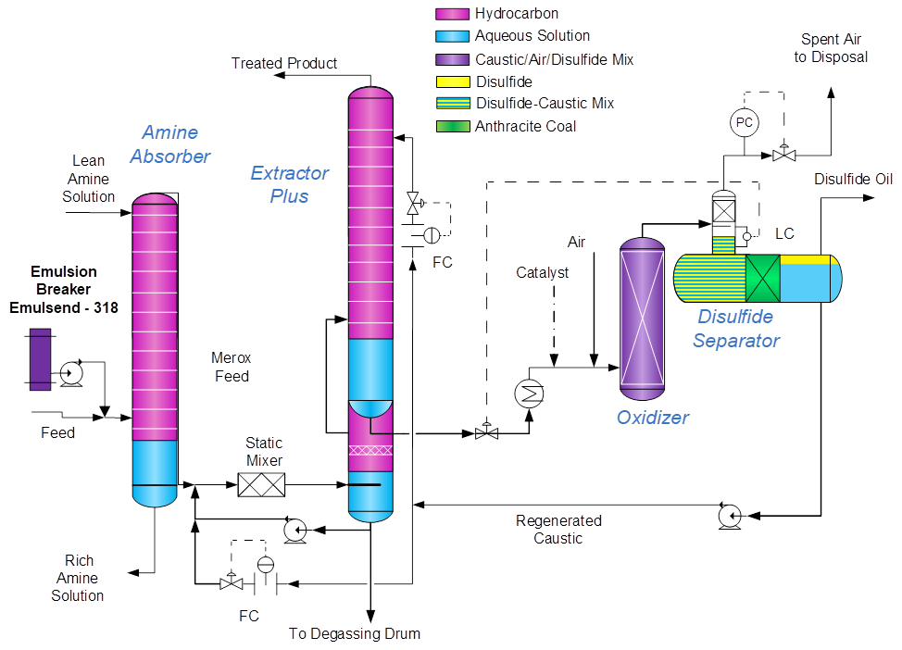
Solution
UOP EMULSION BREAKER

Slide 7
Solution
UOP EMULSION BREAKER
Injection of UOP emulsion breaker upstream of process unit reduce emulsions & carryover
OPERATIONAL BENEFITS
Increase throughput of Amine Absorber & Extraction Merox without revamp
Minimize effect of contaminants from Coker, high severity FCC operation, & FCC co-processing
Less operator intervention required
SUSTAINABILITY
Less waste (amine, caustic, in downstream units)
COMMERCIALLY PROVEN
Successful commercial use and commercial customer trial
Emulsion breakers remain in the hydrocarbon phase
    Compatible with downstream refining processes
    Thermally stable
    Do not affect product quality
Easy online installation & skid design
DIVERSE PORTFOLIO
Address many different emulsion types & applications
    Sour water strippers
    Amine Units & LPG
    Caustic Units

Slide 8
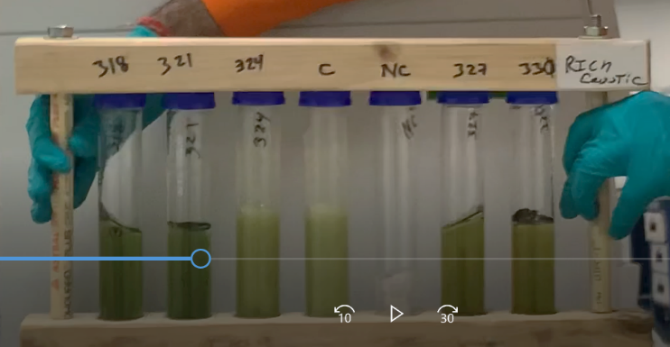
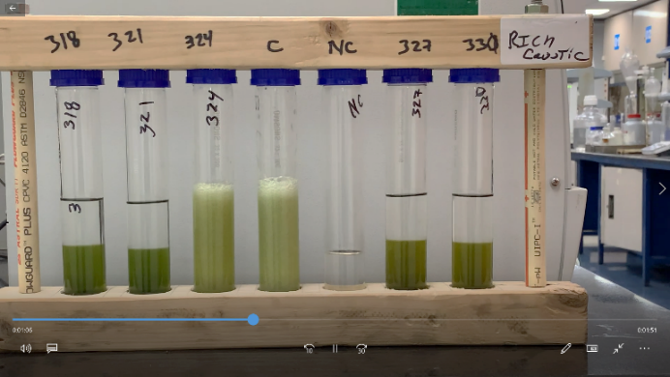
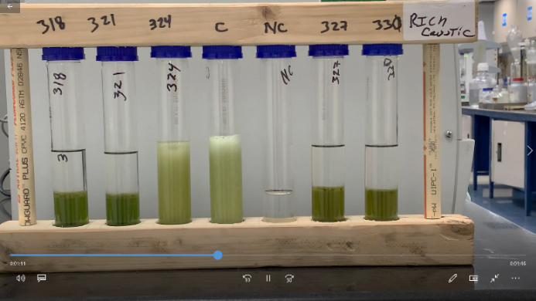
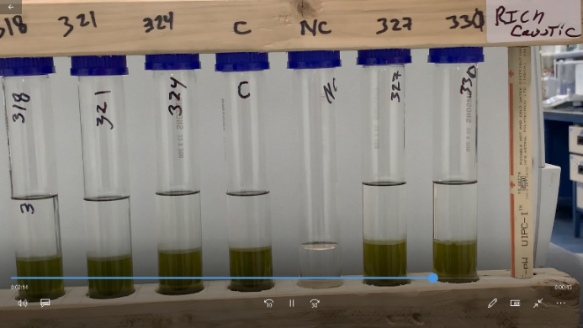
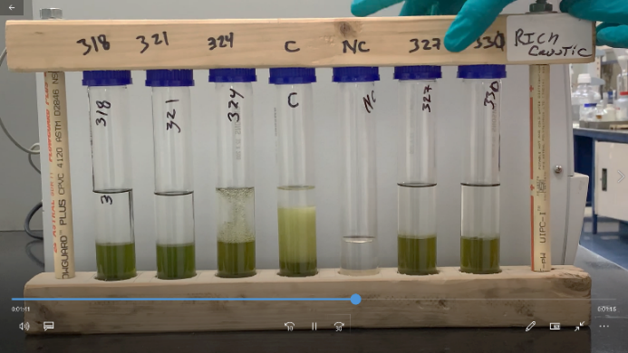
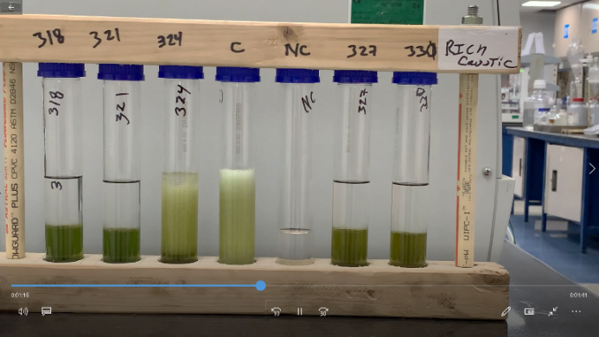
Lab Shake test
With EB
Without EB
With EB
Time: 0 sec
Time: 5 sec
Time: 10 sec
Time: 75 sec
Time: 40 sec
Time: 15 sec
With Emulsion Breaker the lab trial indicated 5x faster separation of HC and aqueous phase

Slide 9
UOP MEROX: MERCAPTIDE SENSORS

Slide 10
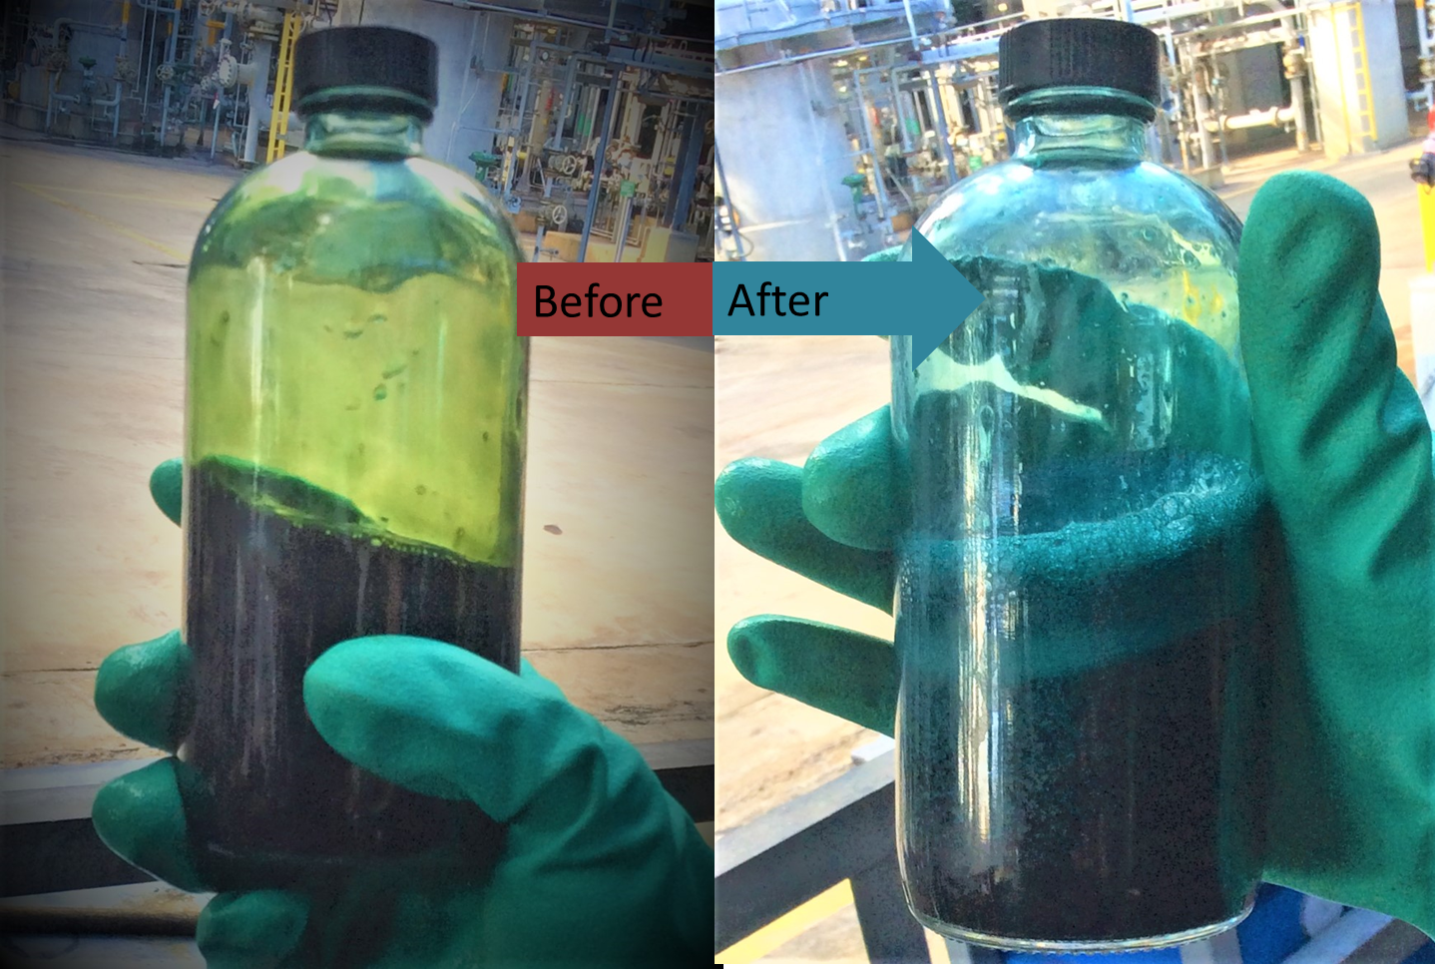
CURRENT MONITORING
SHAKE TEST
Qualitative test to determine degree of
caustic regeneration
Indicates oxidation of mercaptide
Performed by operator once per shift
    Half fill and cap a sample bottle of lean caustic from the disulfide separator
    Begin timed shaking and note the duration
    before a distinct color change
        Dull Green to Bright Blue is the expected change
        30 seconds – 2 minutes
Courtesy of North American Refiner
Shake Test is the Leading Indicator of Unit Health

Slide 11
ENHANCED MONITORING
MEROX MERCAPTIDE SENSOR
Probe installation on rich and lean caustic streams. Digital connection to UOP proprietary algorithm. Digital solution through Process Monitor.
OPERATIONAL BENEFITS
Increased data frequency of mercaptide concentration
Mercaptide readings allow unit optimization & tighter control on key process variables
    Optimize catalyst injection rates
    Optimize air injection
    Optimize caustic circulation
    Optimize water/caustic make-up
Eliminates HSE concerns (no chemical exposure)
COMMERCIALLY PROVEN
Successful commercial use and commercial customer trial
Easy online installation
Minimizes Make-Up and Waste Generation While Maximizing Profits

Slide 12
NEXT GEN CHLORIDE ADSORBENT: CLZ-100

Slide 13
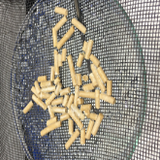
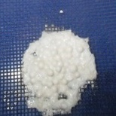
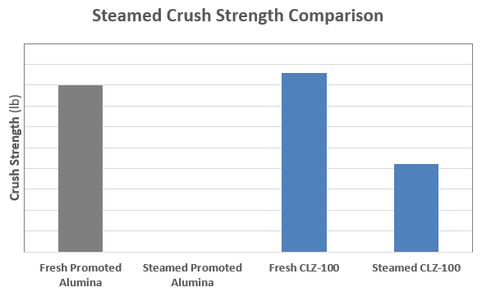
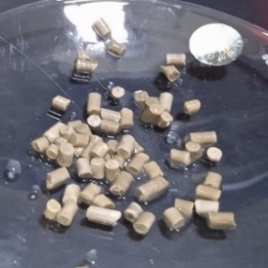
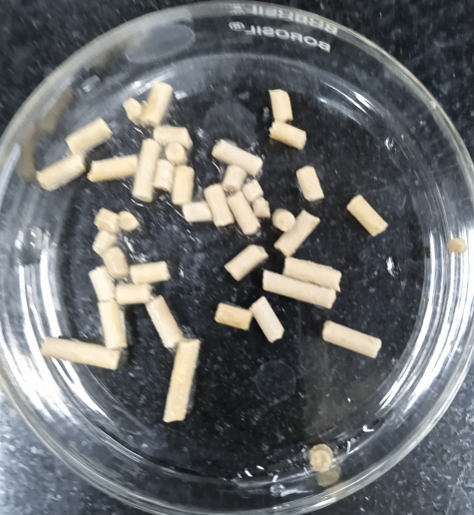
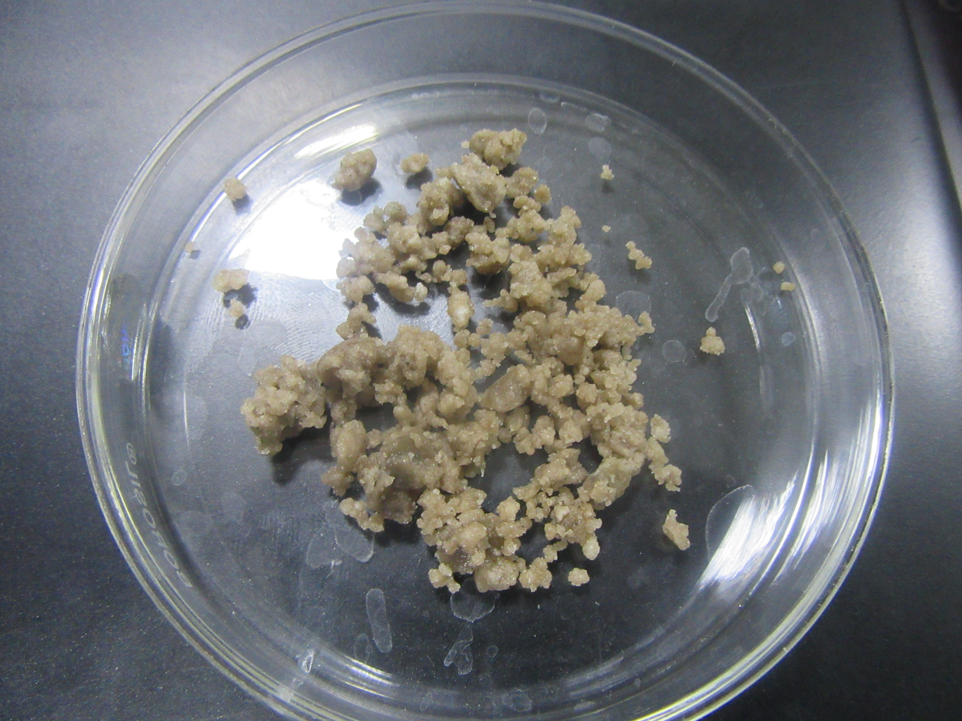
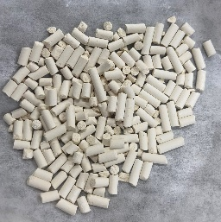
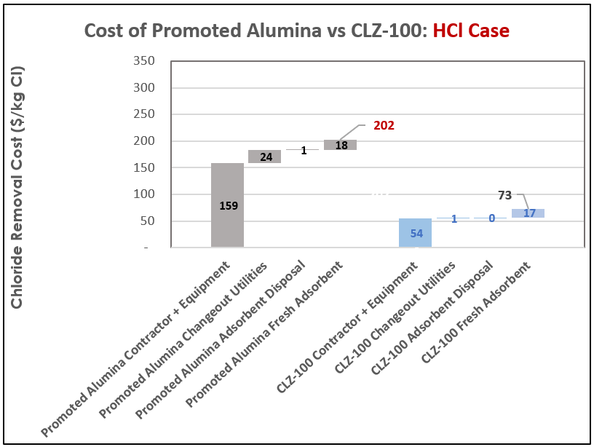
CLZ-100
UOP’S NEXT-GENERATION PRODUCT
UOP’s novel formulation enables:
Excellent mass transfer for a drop-in application
Removal of organic and inorganic chlorides
Improved chloride capacity for fewer changeouts
Hydrothermal stability for steam purging to
minimize nitrogen
Strong physical properties for faster loading
and unloading
Good resistance to net gas liquid condensation
Superior Green Oil resistance compared to
current generation metal oxide and promoted alumina products
Substantially reduces equipment, manpower,
utilities, and disposal costs
Hydrothermal Stability
CLZ-100 remains strong enough for fast unloading after steaming
Typical Promoted Alumina
Source: UOP lab tests
EXAMPLE CLZ-100 Chloride Removal Cost Impact
~64% Lower
[Cl Removal Cost] =
[Contractors / Equipment] + [Utilities] + [Spent Disposal] + [Fresh Adsorbent]
A Step-change in Chloride Adsorbent Performance!

Slide 14
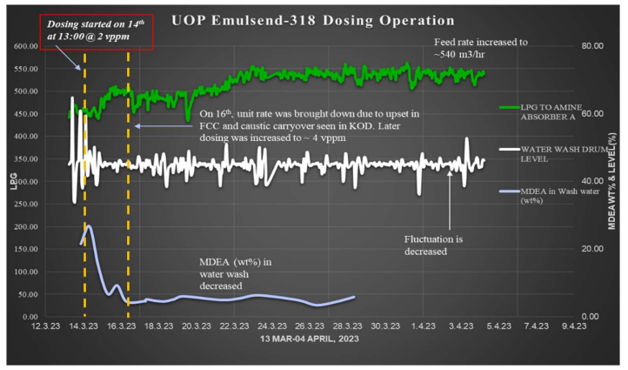
case study increased throughput
PROBLEM & BACKGROUND
LPG Merox Unit designed for 400 m³/hr LPG feed rate
LPG is blend of FCC and Coker LPG
Unit faced amine & caustic carryover issues above
450 m³/hr
TRIAL OPERATION
UOP EmulsEnd-318 was injected upstream of the Amine Absorber in the LPG feed line
    Chemical dosing ranged from 2-5 vppm in the LPG
BENEFITS
Reduction in amine carryover
    Decrease in amine content in the water at the Amine Water Wash Settler – reduced from 21 wt% to 6 wt%
No caustic carryover
    No caustic observed in the Caustic Knockout Drum downstream of the Extractor
Allowed unit throughput to be increased to 540 m3/hr
 | Before Chemical Dosing | After Chemical Dosing | % Change | Comments
LPG feed rate (m3/hr) | 450 | 540 | +20%
MDEA in Water Wash (wt%) | 21 | 6 | -70% | Significant decrease in Amine Carryover
Caustic Carryover in KOD | Frequent above 450m3/hr feed rate | NIL |  | NO caustic carrover

Slide 15
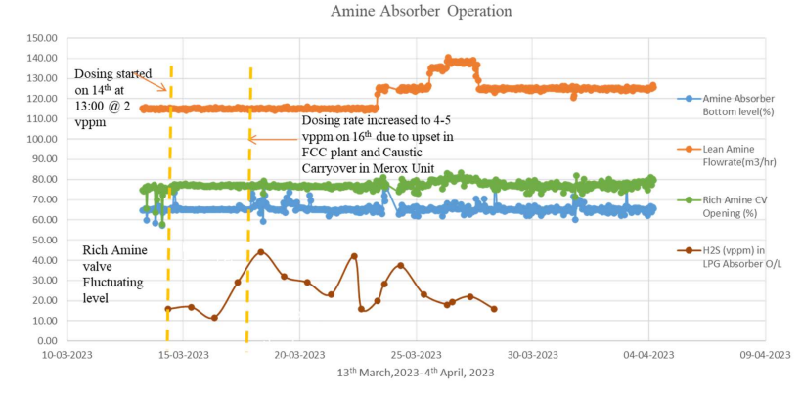
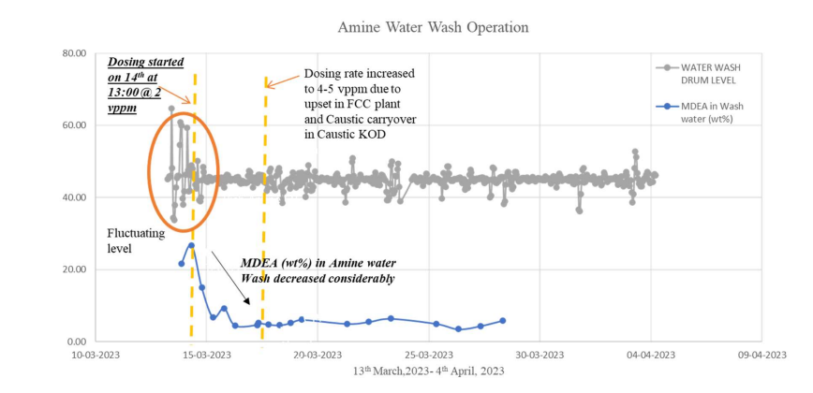
case study increased throughput (CONTINUED)
Amine Absorber Section
H2S content in the LPG to the Merox Prewash decreased to less than 25 vppm
Amine content in the Amine Water Wash Settler remained between 5-6 wt%
No caustic level was observed in the Caustic KOD, indicating no caustic carry over
Amine Water Wash Settler
Amine concentration in the wash water decreased from 21% to about 5 wt% indicating a decrease in amine carryover from the Amine Absorber
Amine carryover in the LPG at the Amine absorber outlet has reduced from 315 kg/hr to 75 kg/hr, representing a reduction of about 2 million kg of amine per year.

Slide 16
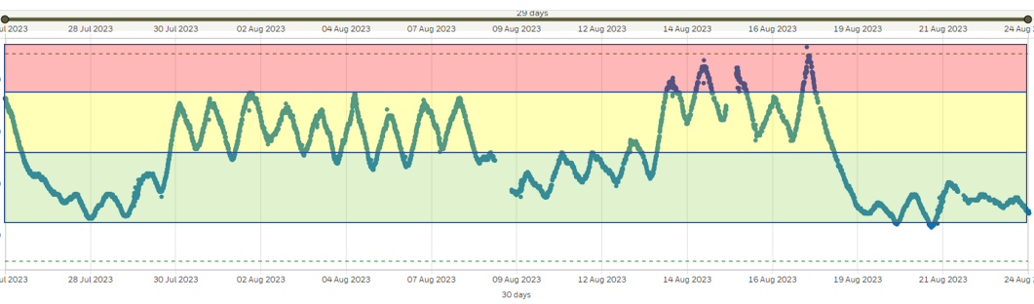
MORE ADVANCED OPERATION MONITORING
Digital solution with clear visualization
Higher frequency data for unit monitoring than current shake test method
Operational recommendations and commentary

Slide 17
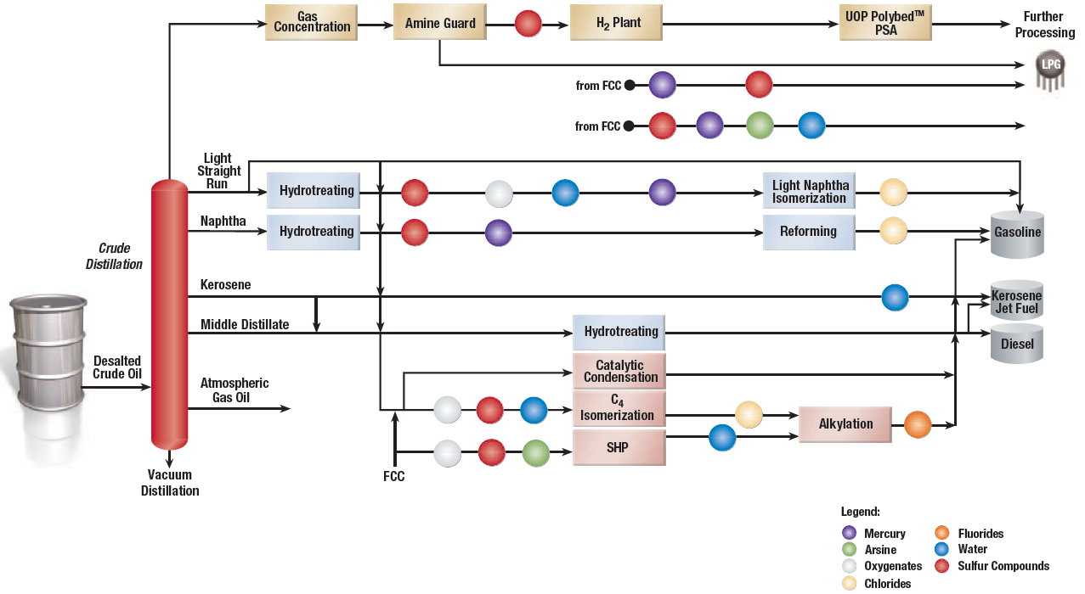
Agenda
I.
Chloride Treating Overview
II.
CLZ-100 Introduction
III.
Case Study
IV.
Q&A
Breakthrough Material!

Slide 18
Common Chloride Adsorbent Materials
  Activated Alumina
    Highly porous non-crystalline
    Inorganic promoters enhance performance, increased capacity
  Molecular sieves
    Crystalline zeolites
    Narrow pore size and well-investigated structures
  Mixed metal oxides
    Amorphous, lower surface area products
    Various metals used: zinc oxide, sodium oxide, carbonates, and bicarbonates
 | CLR-204 | CLR-454 | PCL-100 / PCL-200
Base material | Alumina | Molecular Sieve | Molecular Sieve
Service | Vapor / Liquid | H2 Net Gas | Stabilizer feed
Green oil formation | Very low | Minimal | Very low
Adsorption capacity | Optimum for HCl and good for organic chlorides | Good for HCl and optimum for organic chlorides | Good for HCl and optimum for organic chlorides
Range of materials with different performance and features.

Slide 19

CLZ-100: UOP’s Next-Generation Product
OPTION 1
  UOP’s novel formulation enables:
  Excellent mass transfer for a drop-in application
  Removal of organic and inorganic chlorides
  Improved chloride capacity for fewer changeouts
  Hydrothermal stability for steam purging to minimize nitrogen
  Strong physical properties for faster loading and unloading
  Good resistance to net gas liquid condensation
  Superior Green Oil resistance compared to current
  generation metal oxide and promoted alumina products
A Step-change in Chloride Adsorbent Performance!

Slide 20
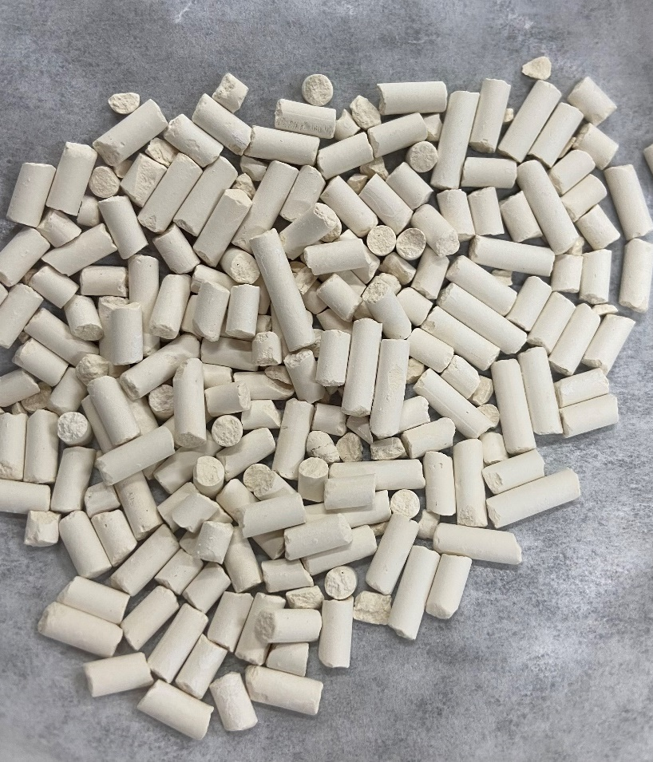

CLZ-100: UOP’s Next-Generation Product
OPTION 2
  UOP’s novel formulation enables:
  Excellent mass transfer for a drop-in application
  Removal of organic and inorganic chlorides
  Improved chloride capacity for fewer changeouts
  Hydrothermal stability for steam purging to minimize nitrogen
  Strong physical properties for faster loading and unloading
  Good resistance to net gas liquid condensation
  Superior Green Oil resistance compared to current
  generation metal oxide and promoted alumina products
A Step-change in Chloride Adsorbent Performance!
Honeywell Confidential - ©2023 by Honeywell International Inc. All rights reserved.

Slide 21
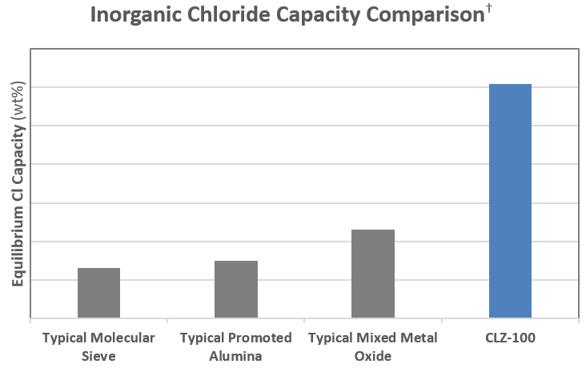
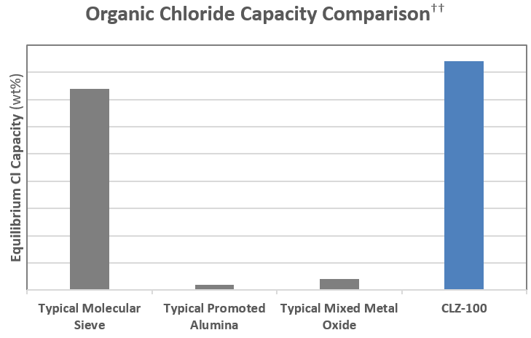
CLZ-100: Chloride Capacity
  CLZ-100 has >3 times the chloride capacity of advanced promoted alumina
  Compared to typical Metal oxide chloride adsorbents,
  CLZ-100 has better dispersion of promoters, higher
  chloride capacity, and faster mass transfer.
  CLZ-100 greatly outperformed Promoted Alumina, even
  at a very short contact time in laboratory tests.
† | Inorganic chloride capacities based on publicly available literatures and UOP testing
†† | Organic chloride capacities based on UOP lab tests
This breakthrough product has the highest HCl & organic chloride capacity
without the rate limitations of typical Metal Oxide product

Slide 22
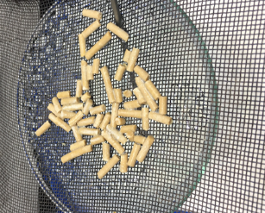
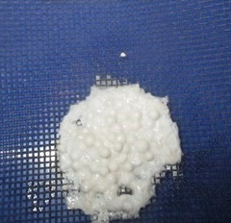
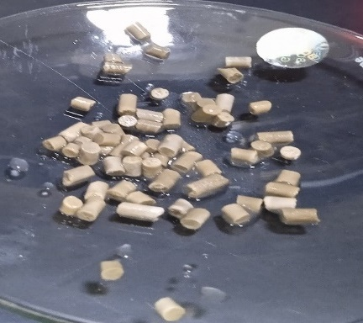
CLZ-100: Hydrothermal Stability
  CLZ-100 remains strong enough for fast unloading after steaming
CLZ-100
Typical Promoted Alumina
CLZ-100
6 hr Steaming
4 hr Steaming
Structural Failure
CLZ-100
Typical MMO
48 hr Steaming
4 hr Steaming
Water Soak
Source: UOP lab tests

Slide 23
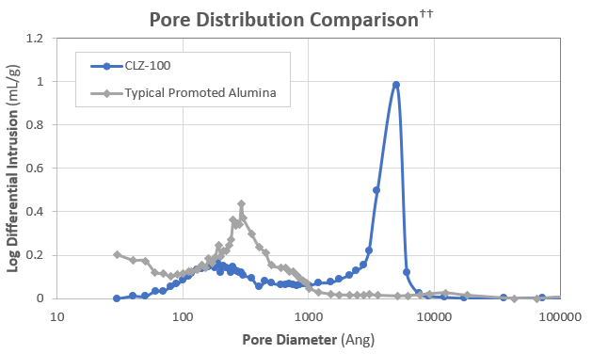
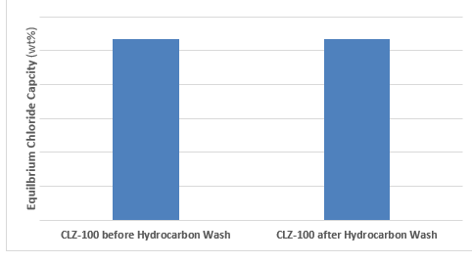
CLZ-100: Recovery from Liquid Condensation
  Lab testing confirms that large macro pores are preferable in handling liquid carry-over
  Optimal porosity also results in higher capacity in
  commercial applications
    Less resistance for contaminant to travel to active surface
    Results in low mass transfer resistance, and high dynamic capacity
Chloride capacity after liquid hydrocarbon exposure

Slide 24
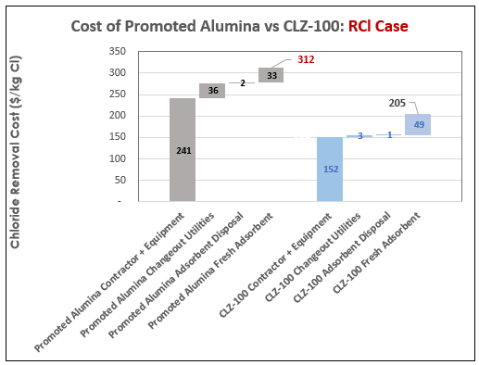
EXAMPLE CLZ-100 Chloride Removal Cost Impact
[Cl Removal Cost] = [Contractors / Equipment] + [Utilities] + [Spent Disposal] + [Fresh Adsorbent]
~34% Lower
~64% Lower
Promoted Alumina Life:
12 weeks/bed
CLZ-100 Life:
19 weeks/bed
Promoted Alumina Life:
12 weeks/bed
CLZ-100 Life:
35 weeks/bed
Organic chloride (RCl) controls the breakthrough time:
2.5 vppm HCl + 0.6 vppm RCl
HCl breakthrough controlling case: 4.6 vppm HCl + 0.1 vppm RCl
CLZ-100 substantially reduces equipment, manpower, utilities, and disposal costs

